Slide 1

Inventory Mangement System (IMS)
QA – Training Project
-Vaidehee Patel
Sorry did it in a hurry do might be messy

Slide 2
Agile
Scope and Project Vision
Product Backlogs
Sprint
    Sprint planning
    Implementation
    Sprint review
    Sprint retrospective
Deployment

Slide 3
MoSCoW
Must have – min. req. CURD functionality for customer order and item entities.
Should have – access restrictions, so that the customer can't change item info/ other customer's info/ other cusstomer's order
Could have – seperation of end user interface into sub-interfaces for the customers and the system developers.
Won't have – image for each item

Slide 4
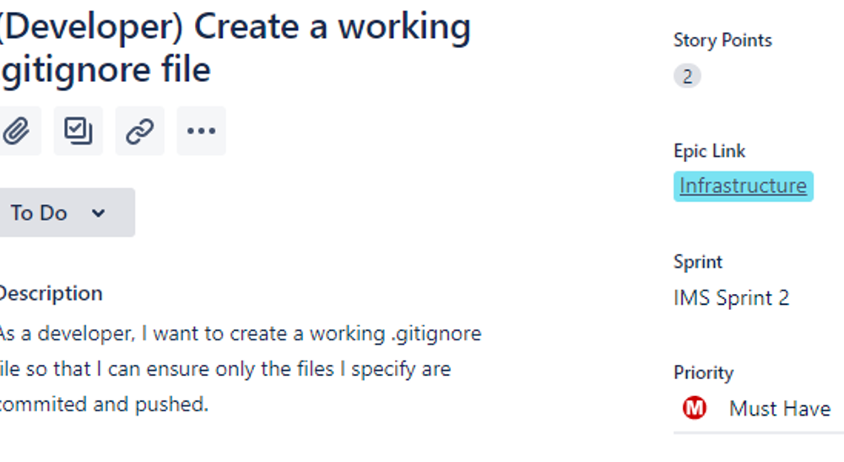
MoSCoW Prioritizing

Slide 5
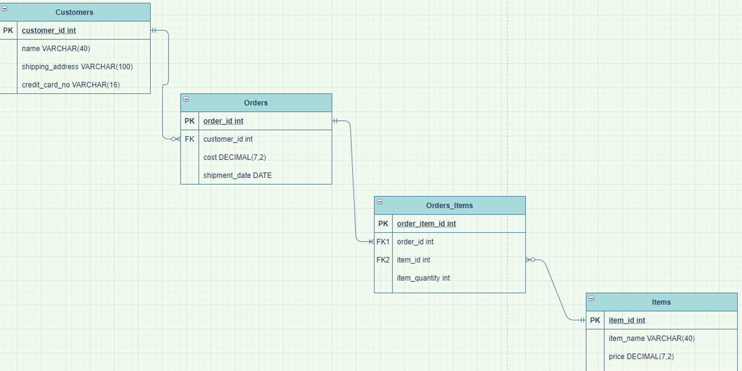
Entity Relationship

Slide 6
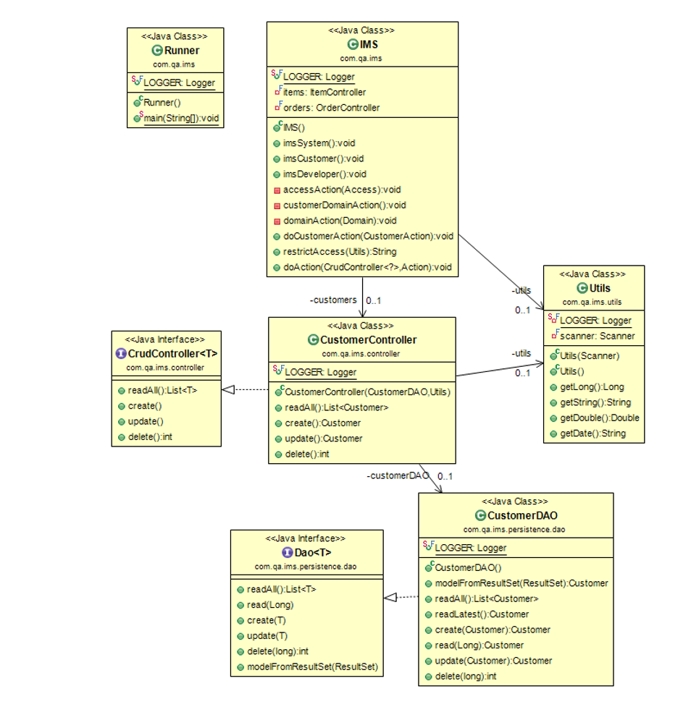
UML

Slide 7
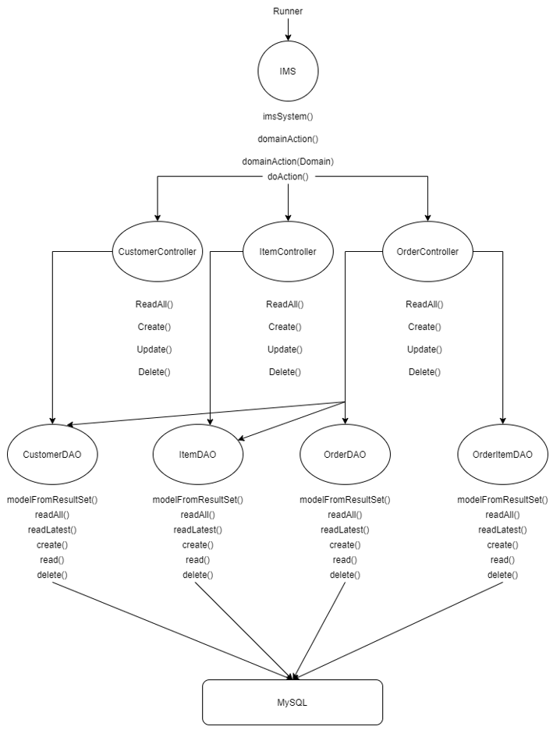
ERD

Slide 8
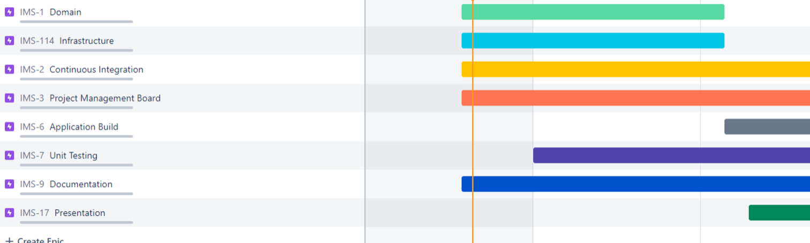
JIRA

Slide 9
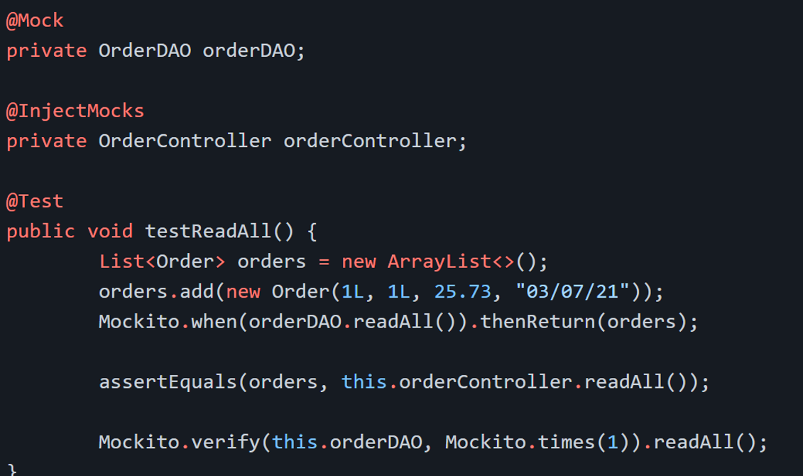
Testing

